Slide 1
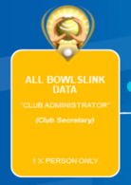
Ballarat and District Bowls Division
Is Your Club Ready – Club Administrator
Updated Finance/Member records
New members Added
Email Campaign
Online Club Championships
Tournaments
Recommend 3 people have Club Administrator profile (Club Secretary + Assistant + Match Committee/Other)
Can export the membership list

Slide 2
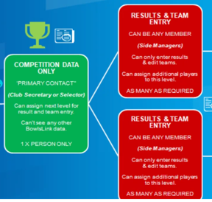
Ballarat and District Bowls Division
Pennant
Bendigo Pennant Results example
https://bendigodivisionbowls.bowls.com.au/pennant/
Best Practices
Selection – what ever you did last year + add players into Bowlslink
Game day – Covid Safe Practices, Enter results –
Ensure Away Managers are either Bowlslink savvy or have an alternative
Update to Bowlink can be done on most PC/Laptop/tablet/smart phone – have it pre set up to access bowlslink
“Dummy member” is primary contact – you can change
OOPs – any issues/mistakes after game is advised email BDBD with copy of Team sheet and what the issue is. Remember this is new to us too

Slide 3
Ballarat and District Bowls Division
Pennant
Best Practices
Selection – what ever you did last year + add players into Bowlslink
Game day – Covid Safe Practices, Enter results –
Ensure Away Managers are either Bowlslink savvy or have an alternative
Update to Bowlink can be done on most PC/Laptop/tablet/smart phone – have it pre set up to access bowlslink
“Dummy member” is primary contact – you can change
OOPs – any issues/mistakes after game is advised email BDBD with copy of Team sheet and what the issue is. Remember this is new to us too
Training materials
Latest at Bowls Vic Including video and manual
https://www.bowlsvic.org.au/clubassist/bowlslink/
Pennant info is in webinar 3 but there are other webinars for membership, email campaign etc
BDBD also has info on Pennant page and BowlsLink info page https://ballaratdistrict.bowls.com.au/bowlslink-info/

Slide 4
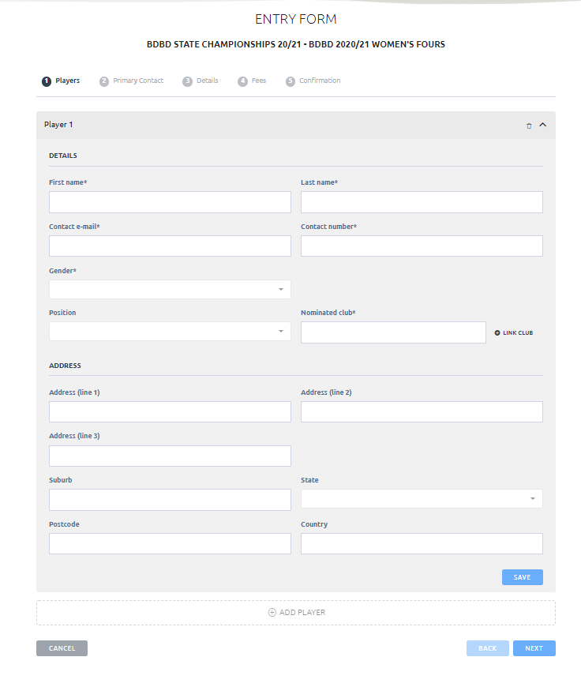
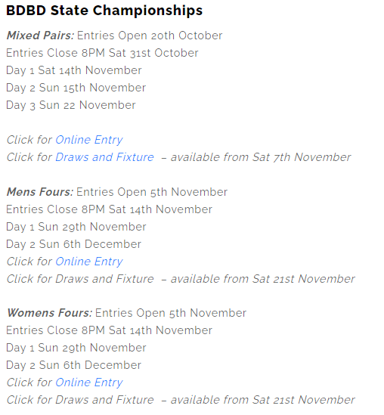
Ballarat and District Bowls Division
State Championships
Details on BDBD website. https://ballaratdistrict.bowls.com.au/competitions/

Slide 5
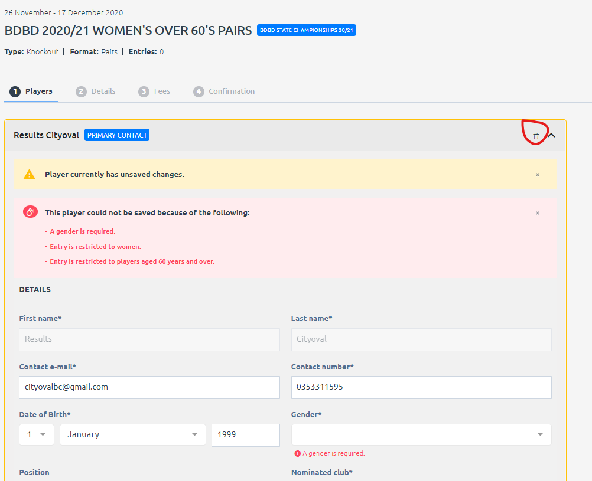
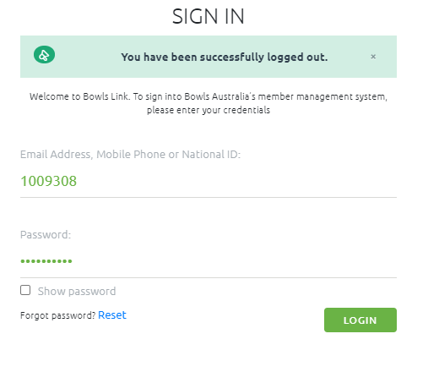
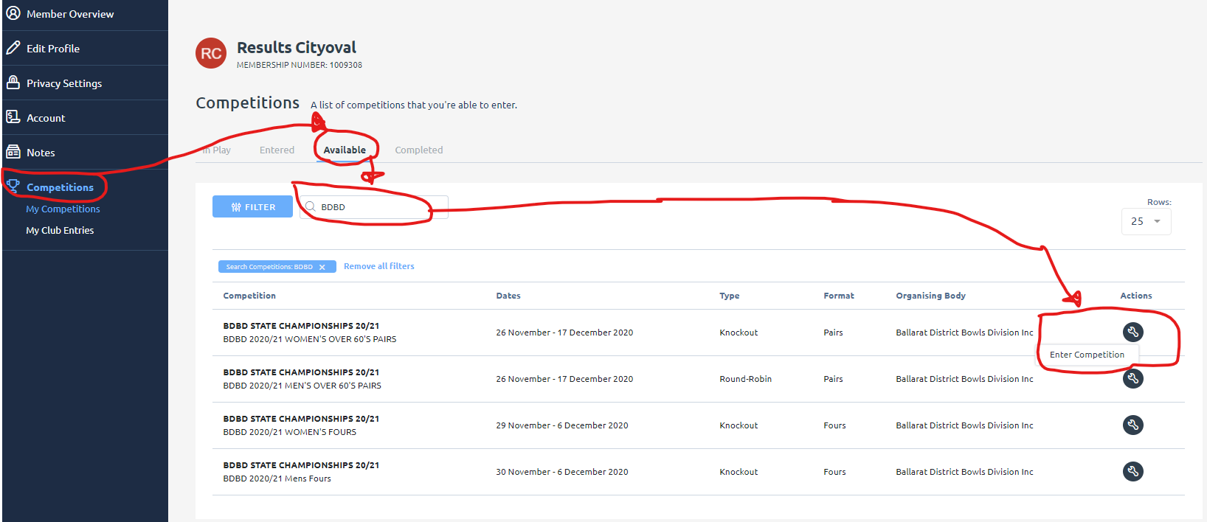
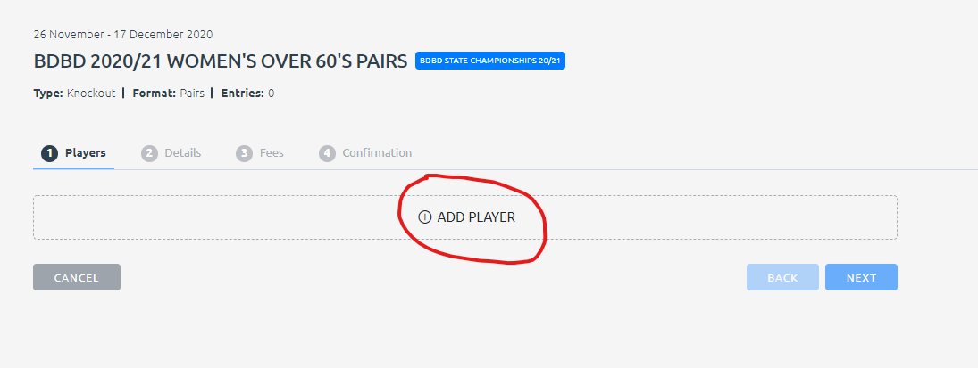
Ballarat and District Bowls Division
State Championships
Entry via Bowlslink https://bowlslink.com.au/
If you are entering on behalf of some one else Click on the Delete (Trash can)
Click on Add Player

Slide 6
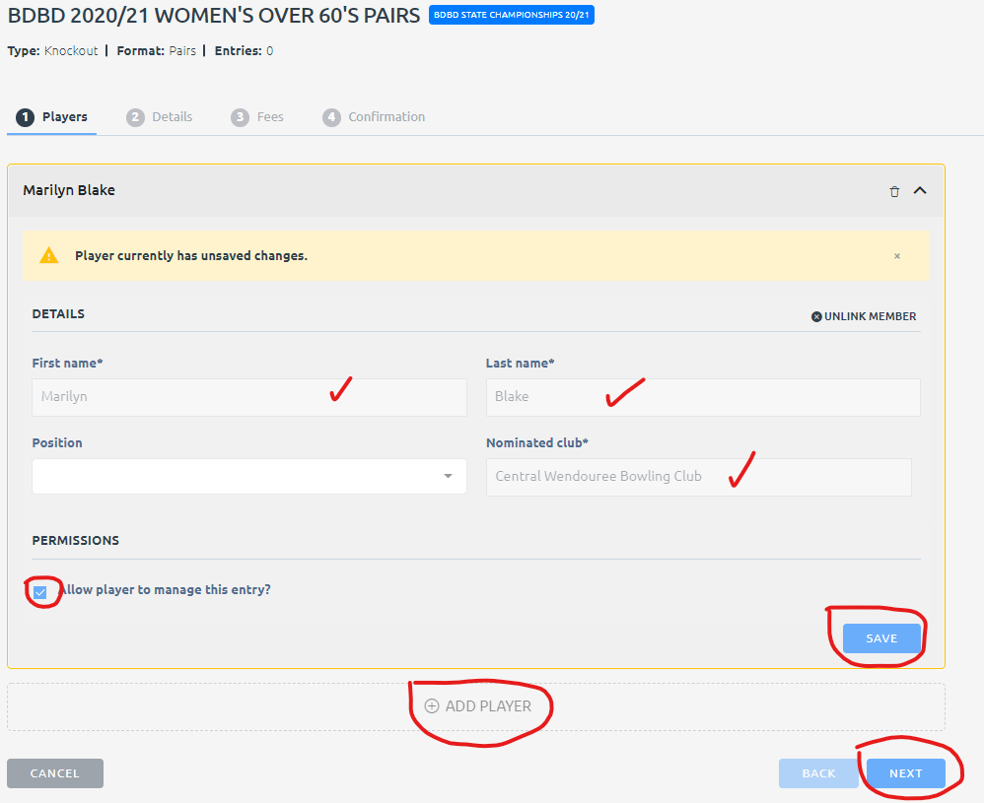
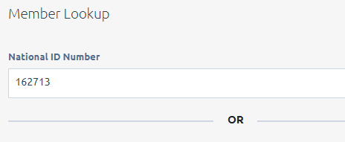
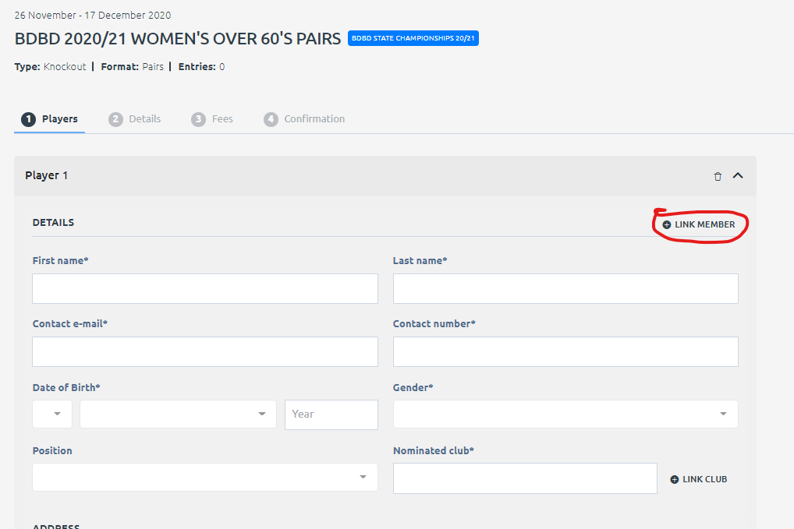
Ballarat and District Bowls Division
State Championships
Entry via Bowlslink https://bowlslink.com.au/ or guest entry
Repeat Add player for each player

Slide 7
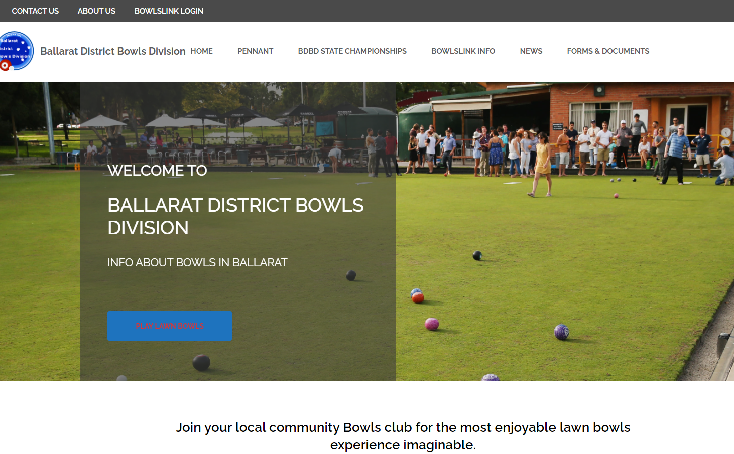
Ballarat and District Bowls Division
Webpage
Advise BDBD what information you would like to see on the site https://ballaratdistrict.bowls.com.au/

